Slide 1
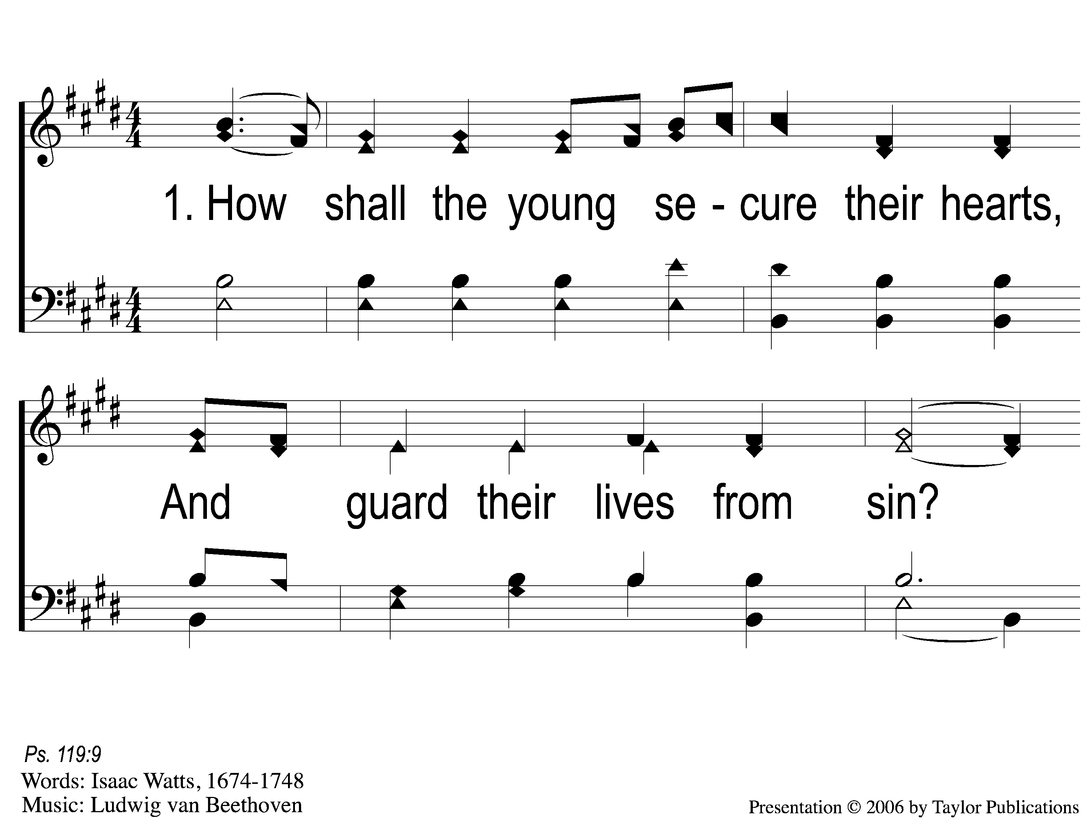
1-1 How Shall the Young Secure
How Shall the Young Secure
179

Slide 2
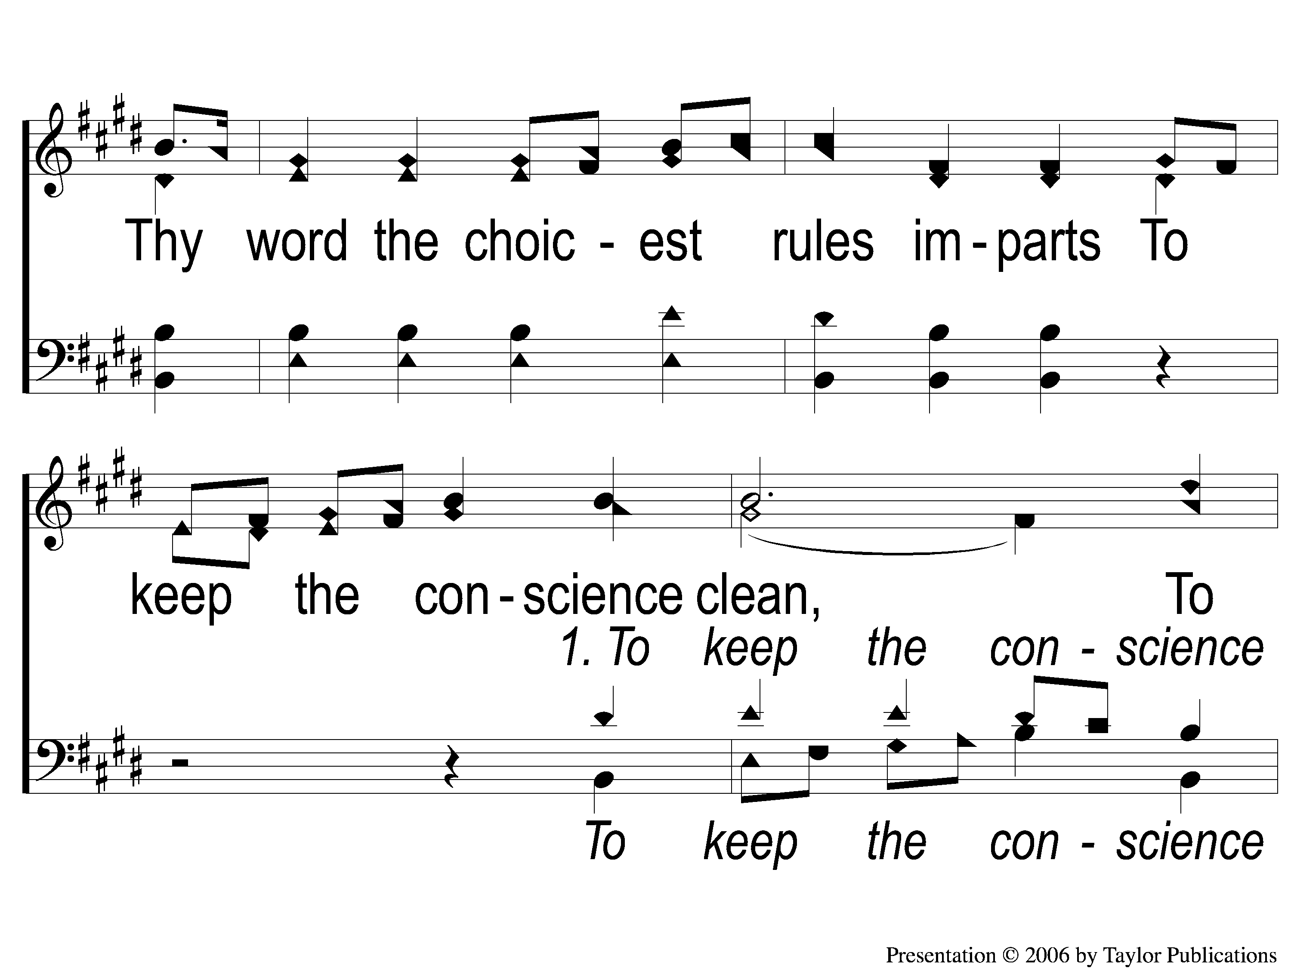
1-2 How Shall the Young Secure
How Shall the Young Secure
179

Slide 3
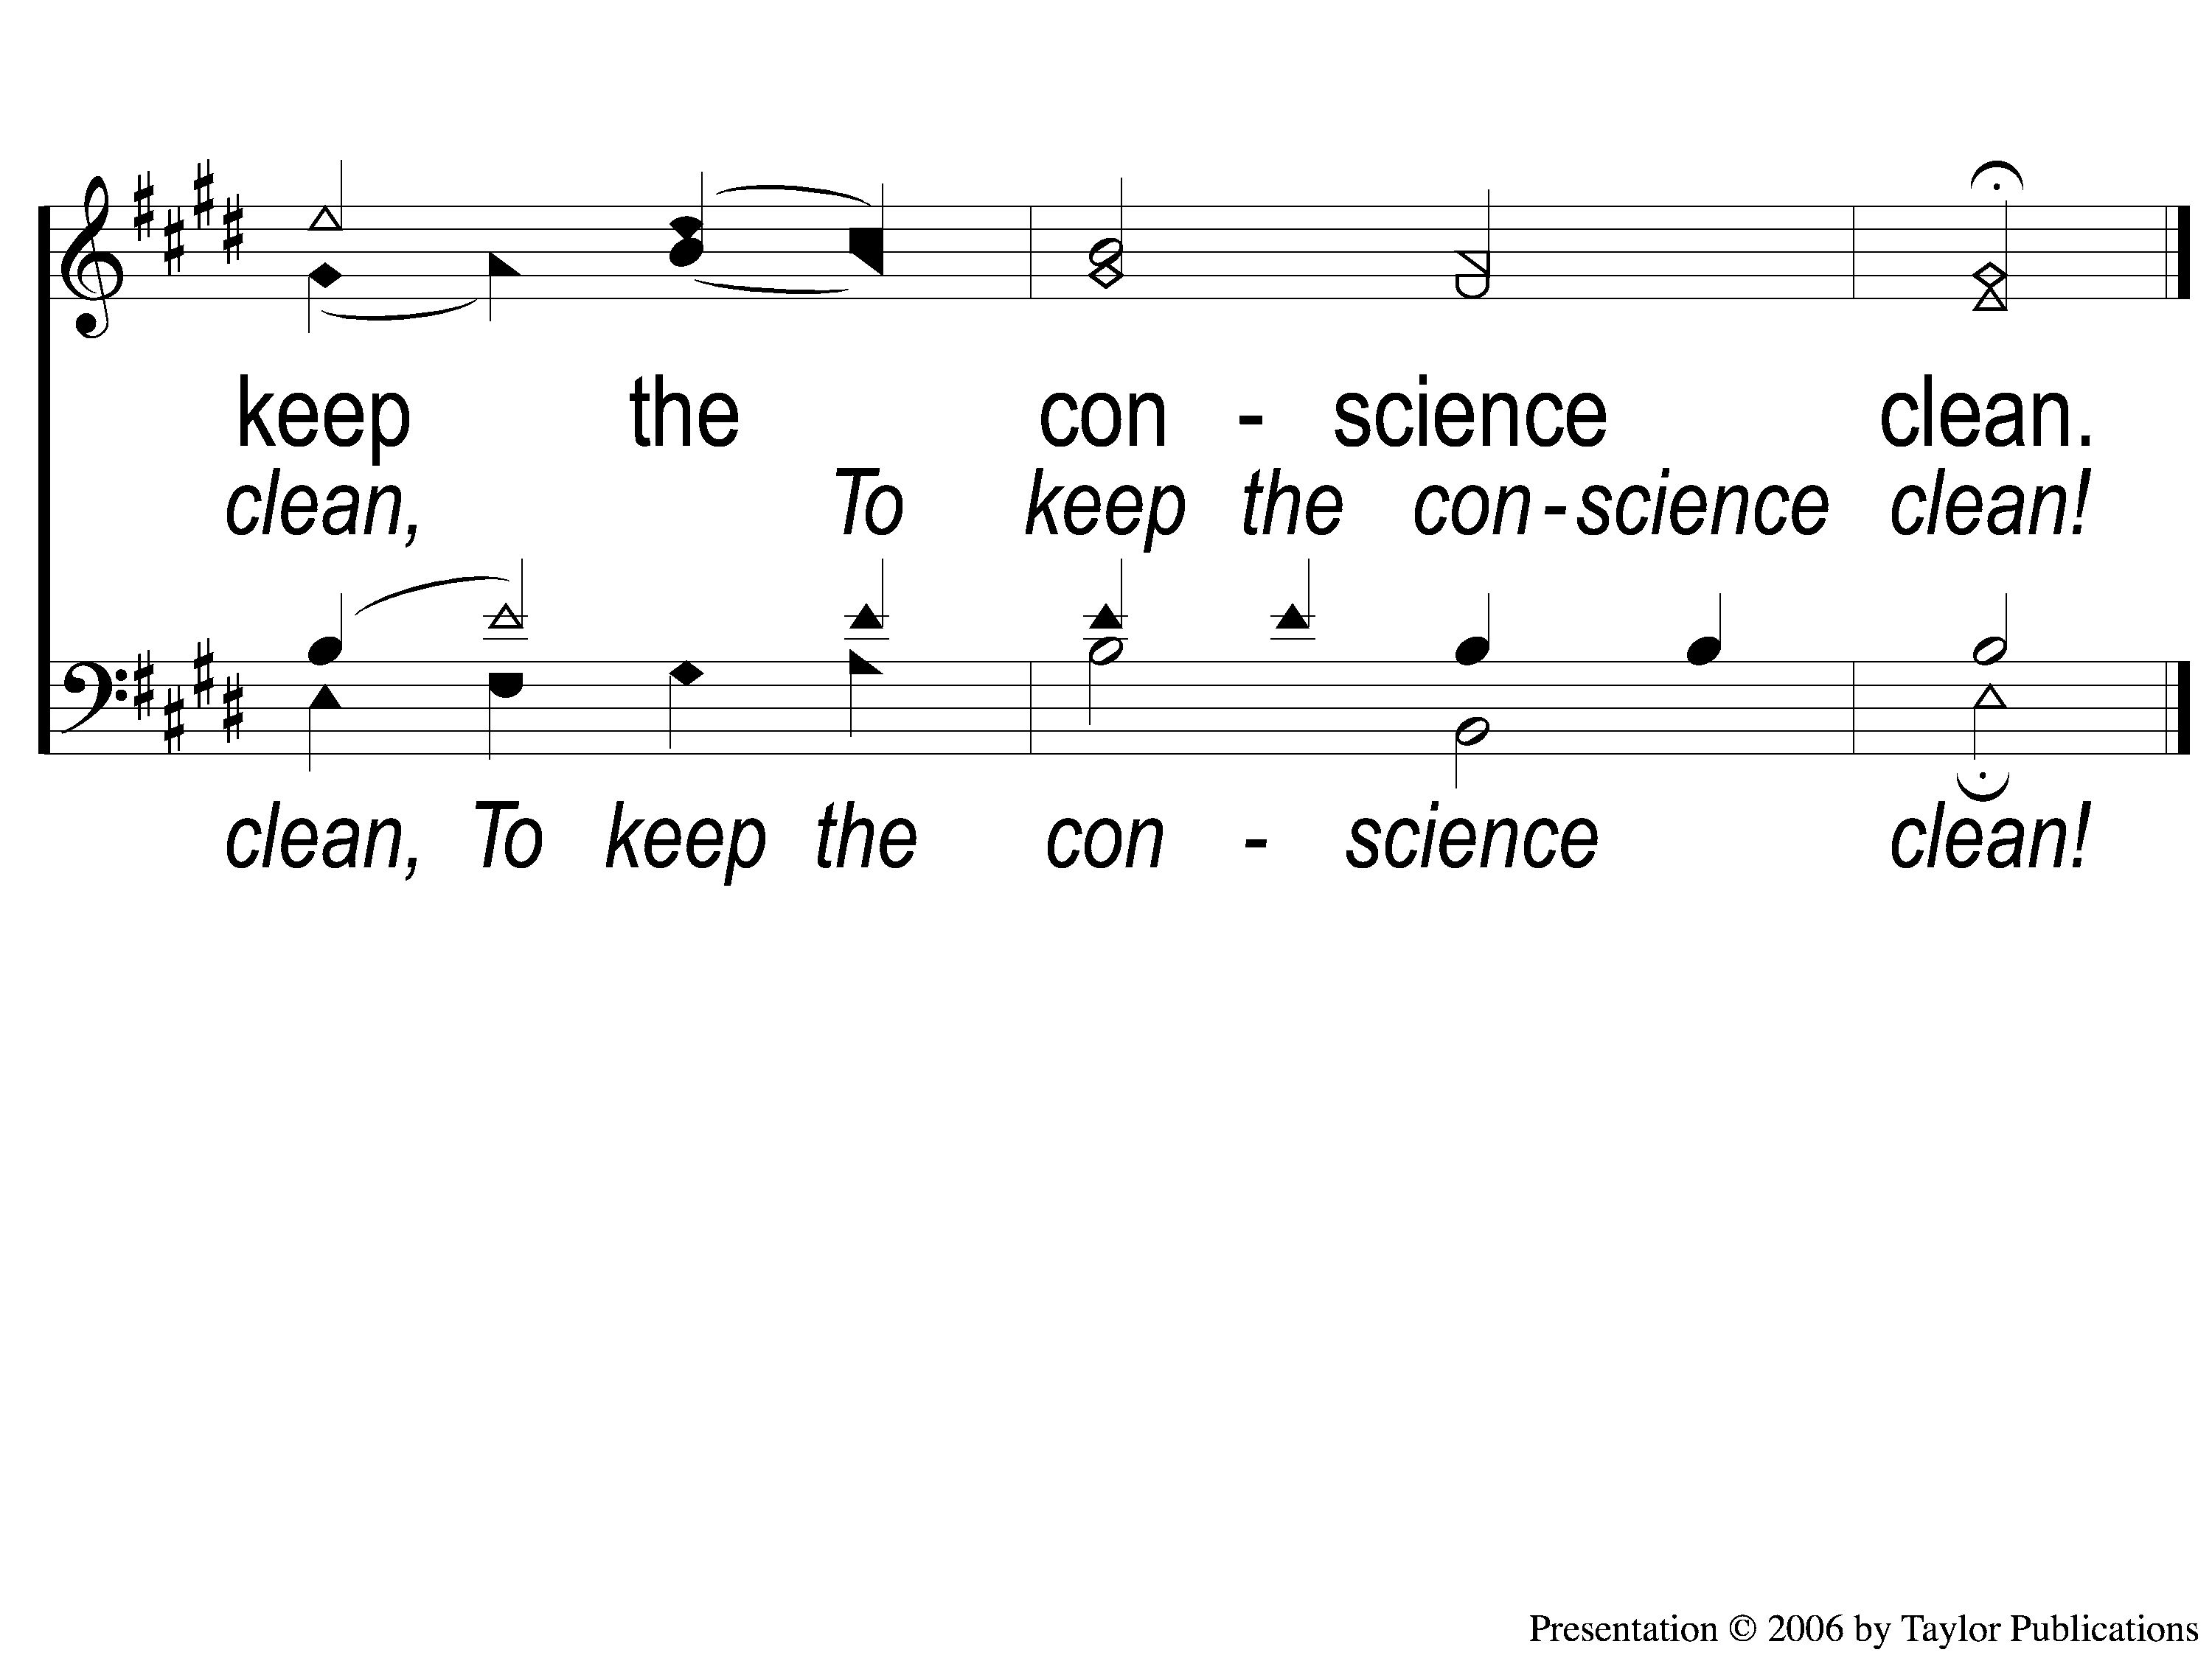
1-3 How Shall the Young Secure
How Shall the Young Secure
179

Slide 4
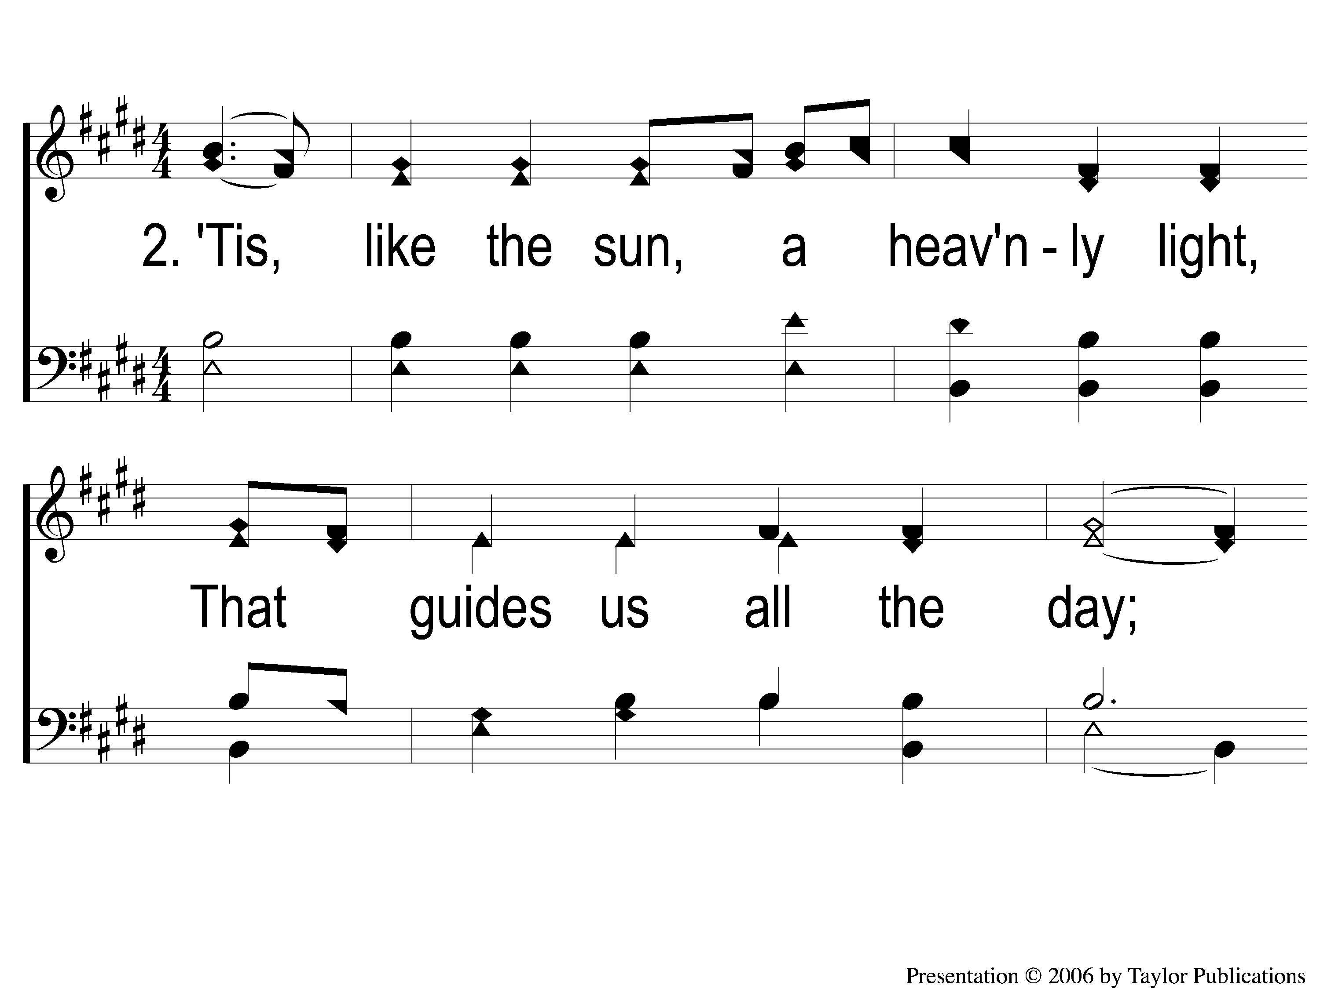
2-1 How Shall the Young Secure
How Shall the Young Secure
179

Slide 5
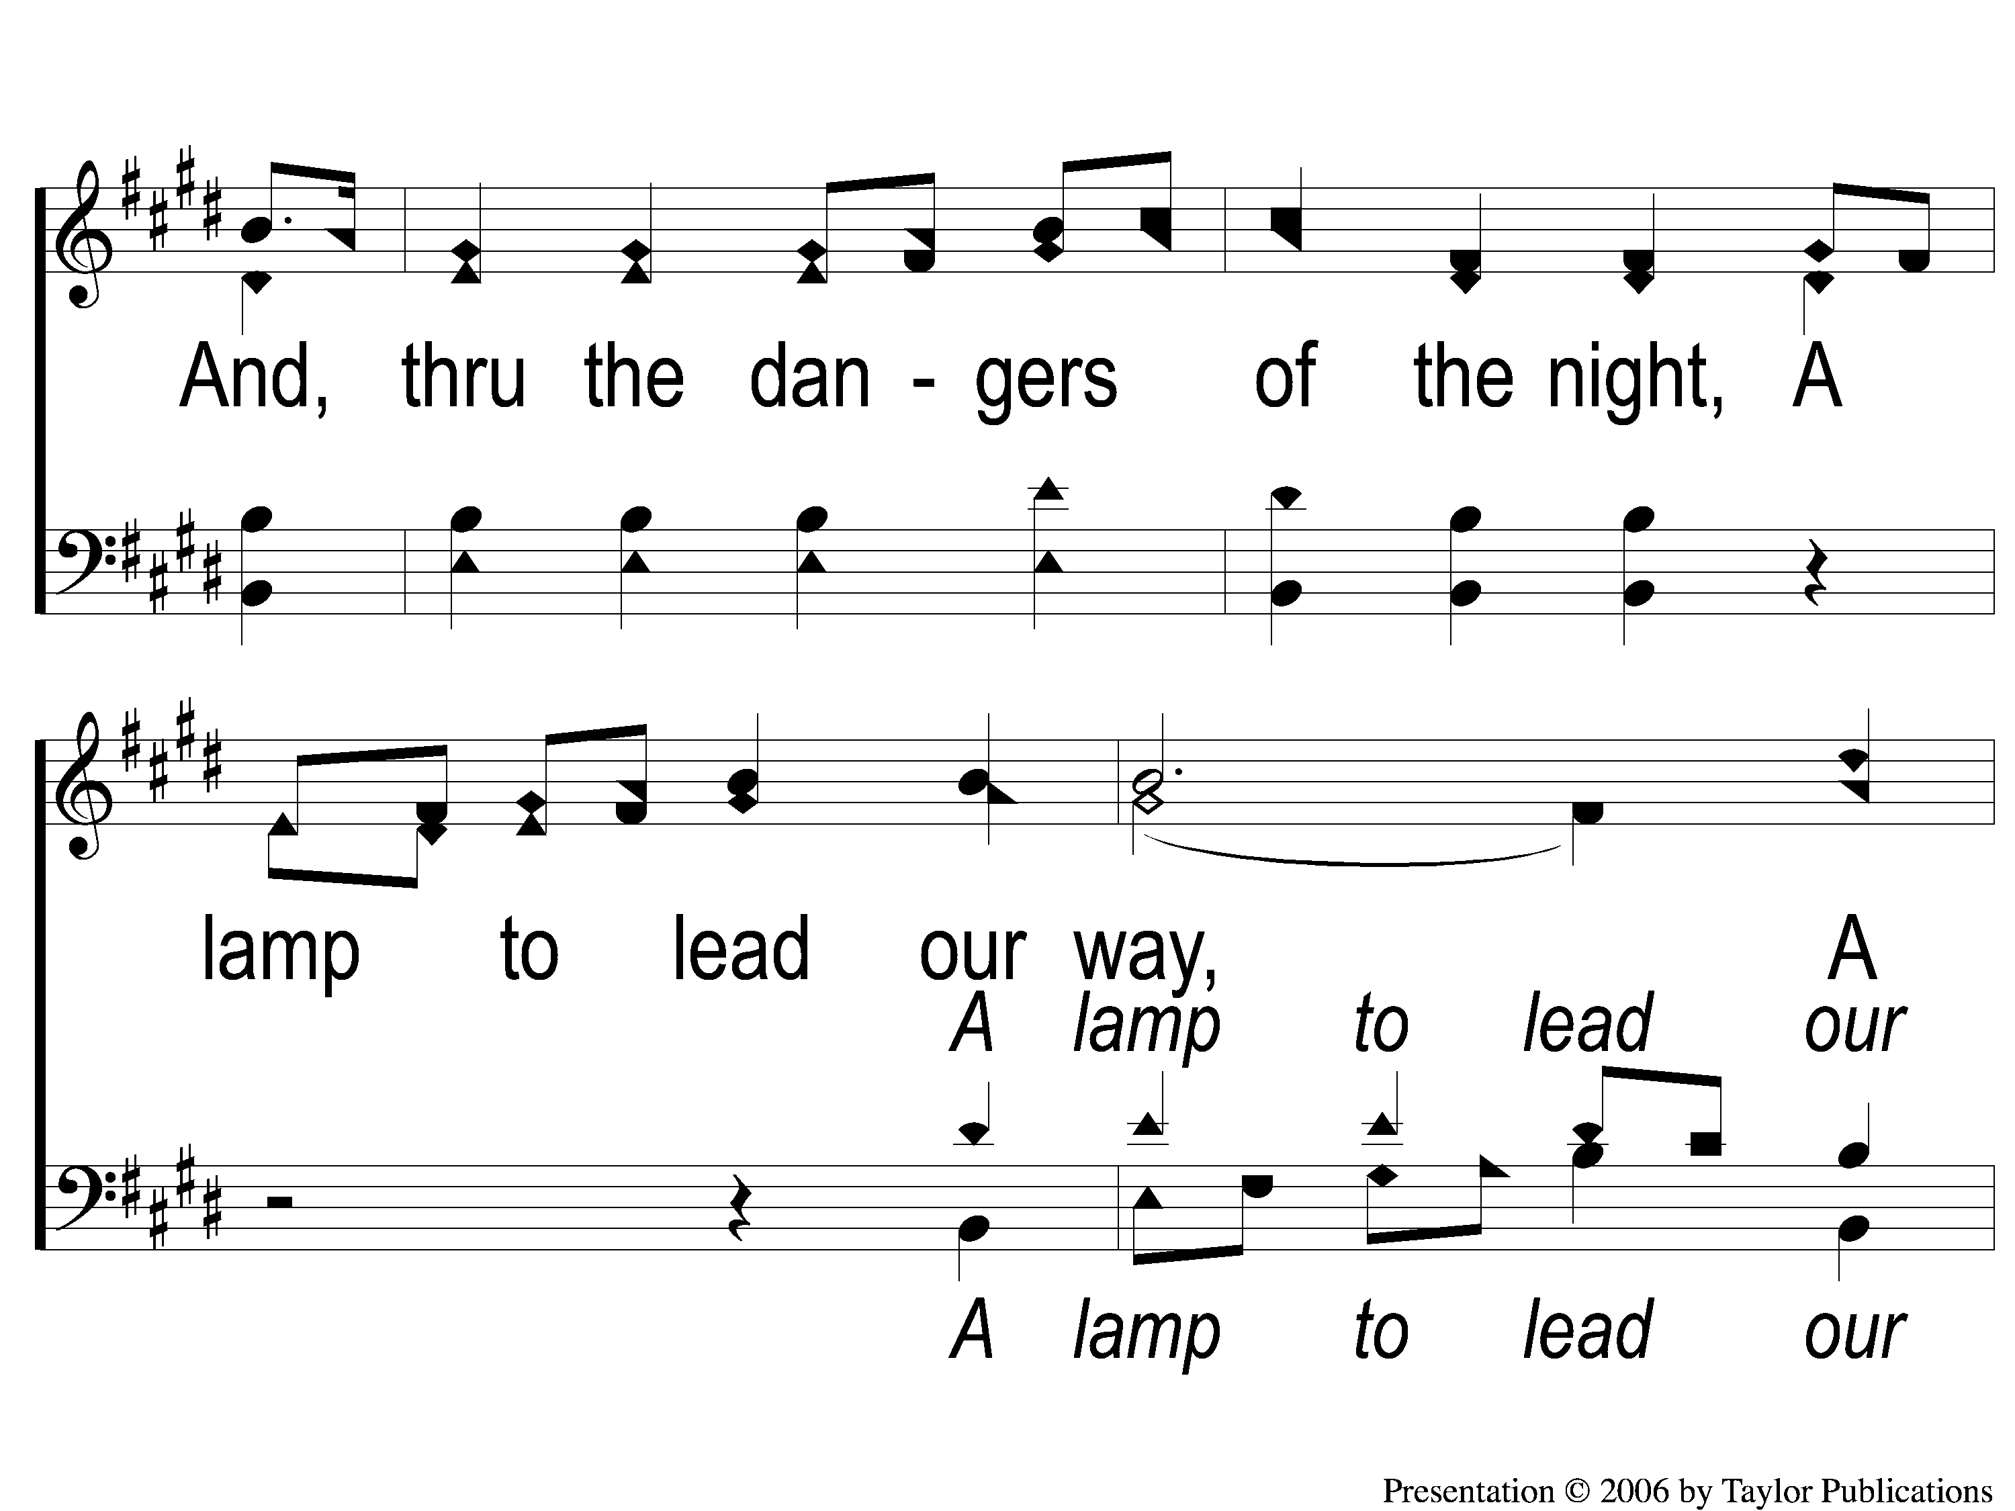
2-2 How Shall the Young Secure
How Shall the Young Secure
179

Slide 6
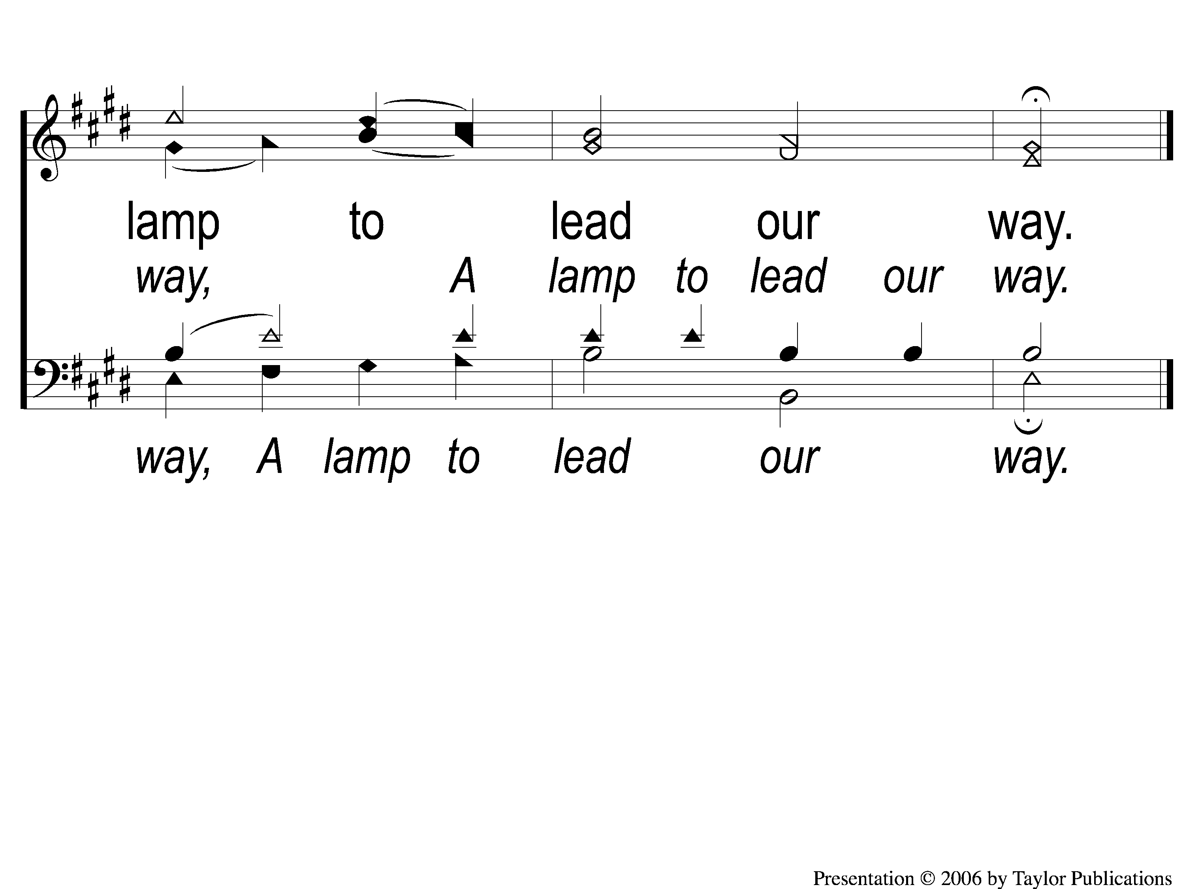
2-3 How Shall the Young Secure
How Shall the Young Secure
179

Slide 7
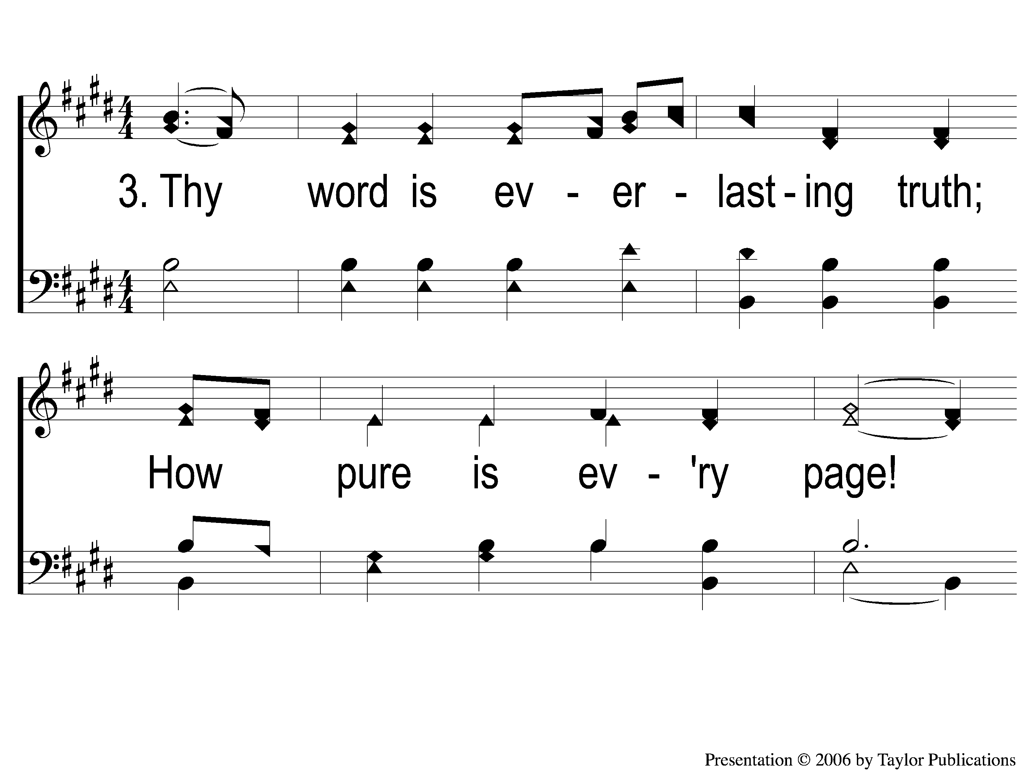
3-1 How Shall the Young Secure
How Shall the Young Secure
179

Slide 8
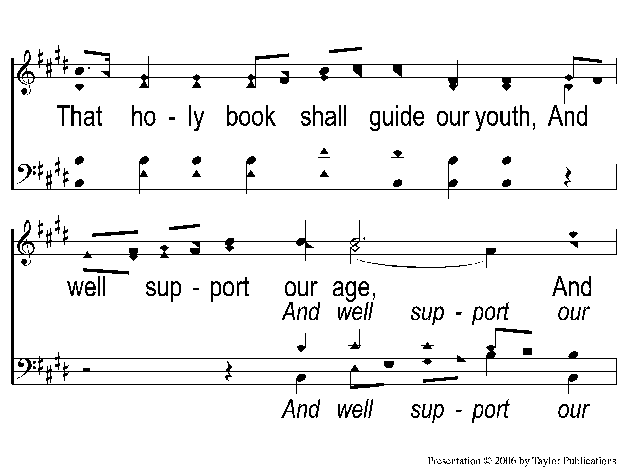
3-2 How Shall the Young Secure
How Shall the Young Secure
179

Slide 9
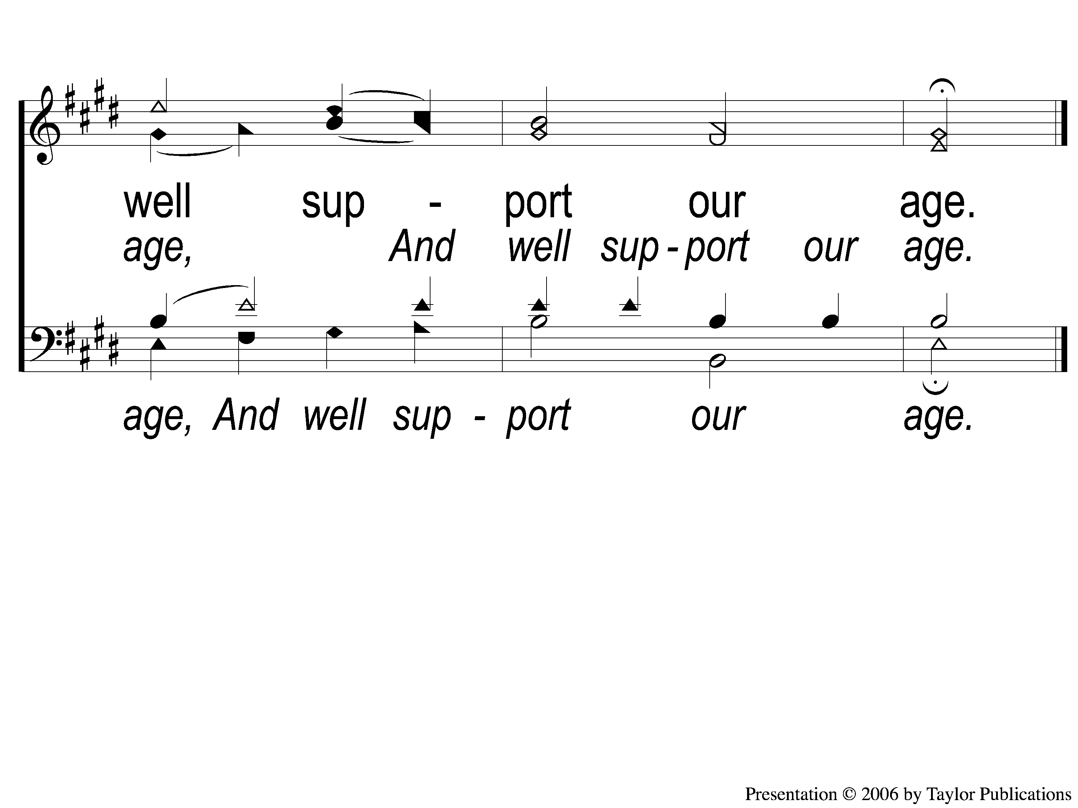
3-3 How Shall the Young Secure
How Shall the Young Secure
179

